Slide 1
C300 Final Evaluation
Project ID:
SOI-2020-2020-0028
Project Title:
Customer Service Bot for a HR Recruitment Agency
Team ID:
SOI-2020-044
Team Members:
18009228 Iskandar Syah
18008635 Liew Koh Jun
18008532 Greg Lau Kai Jie

Slide 2
Table of Content
Introduction
Project Specification
Workflow
Delegation of task
Use Case Diagram
ERD
Gantt Chart
Task Allocation
Records of Team Meeting
Demonstration

Slide 3
Introduction
This project aims to solve Oaktree Consulting’s problem of having countless repetitive HR enquiries that can be answered with ease.
CS Bot as a solution will help to respond to these enquiries and thus lead to an increase in productivity and the reduce time and resources used.
Notes:
Aqilah

Slide 4
Project Specification
Requirements of the project
Develop a Customer Service chatbot for Oaktree Consulting using IBM Watson Assistant to streamline HR support queries by automating the dialog flow.

Slide 5
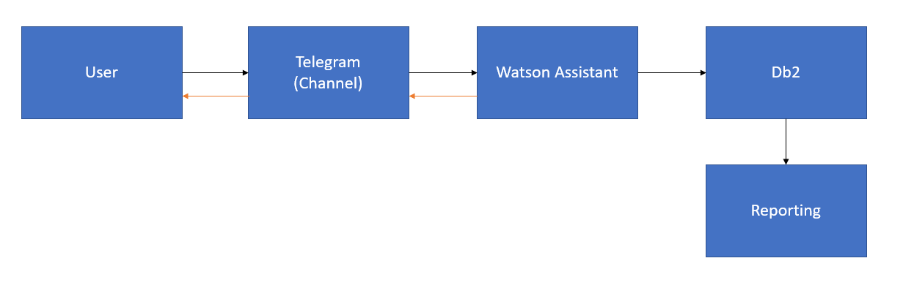
Workflow
Web Scrape
Telegram API > Watson Assistant > Db2 (node-red) User inputs through Telegram, Telegram calls Watson Assistant for Job Data Job Data is returned to the user through Telegram

Slide 6
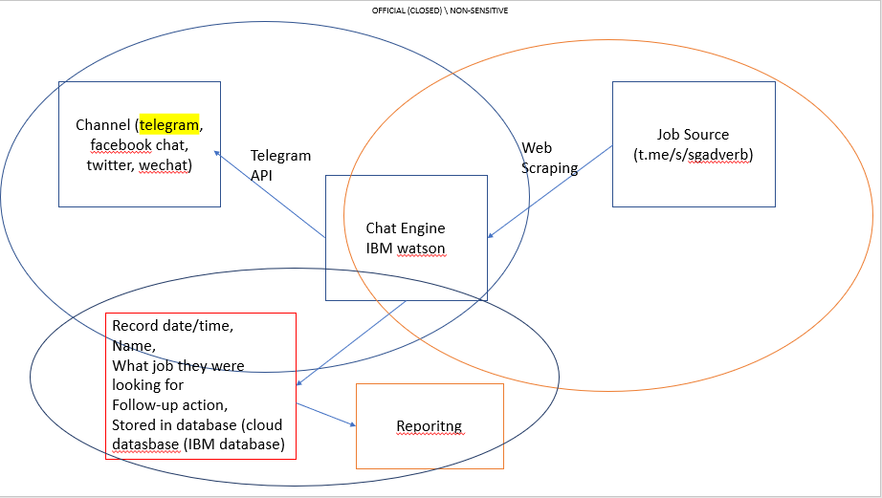
Tasks Allocation
Koh Jun
Iskandar
Channel ( Telegram/ Web)
Job Source (Monster.com/indeed.com
Greg

Slide 7
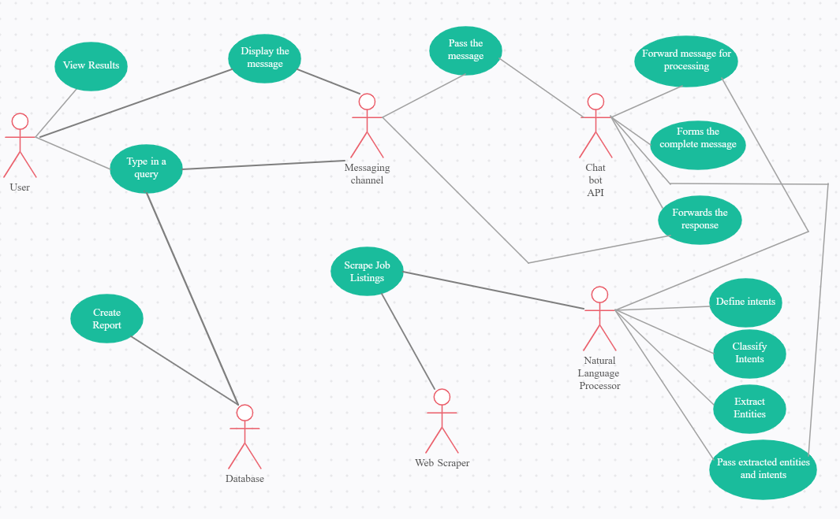
System Design (User Case Diagram)
Notes:
Aqilah

Slide 8
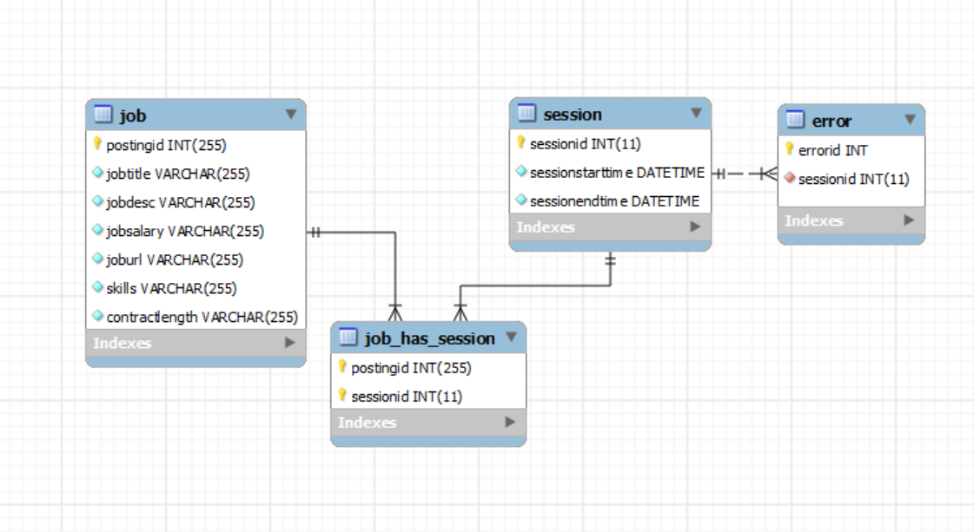
System Design (ERD)
Notes:
Aqilah

Slide 9
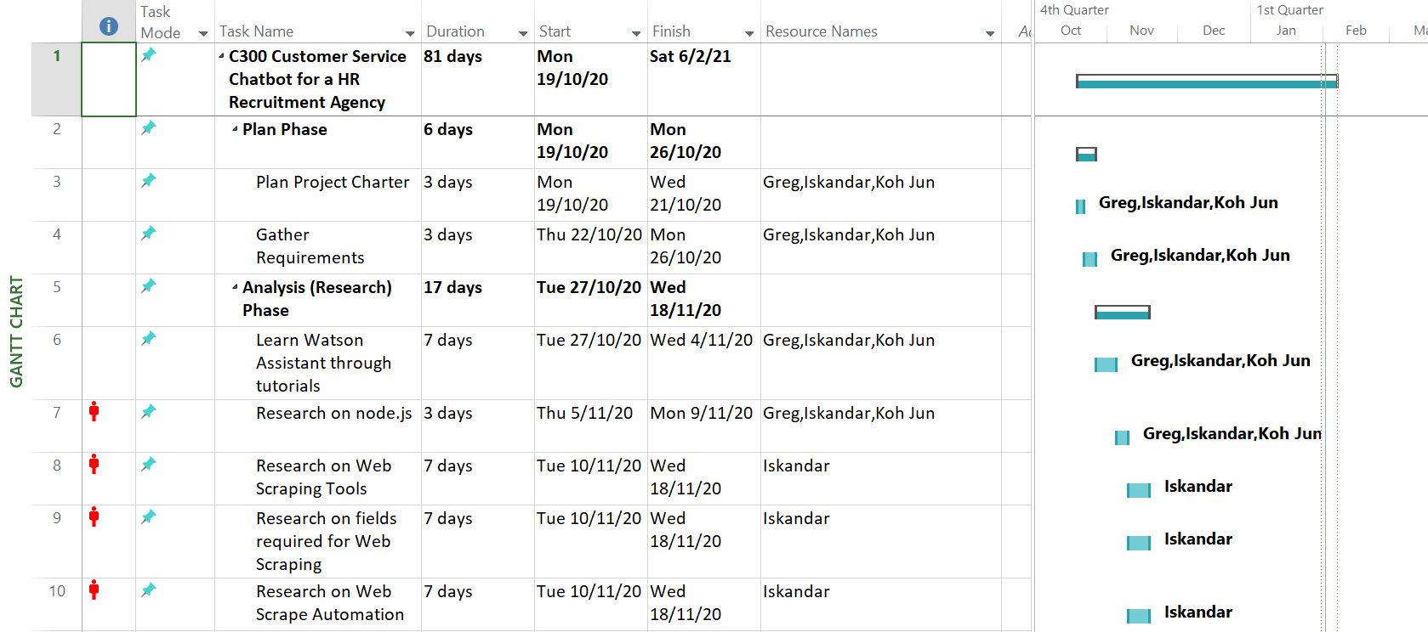
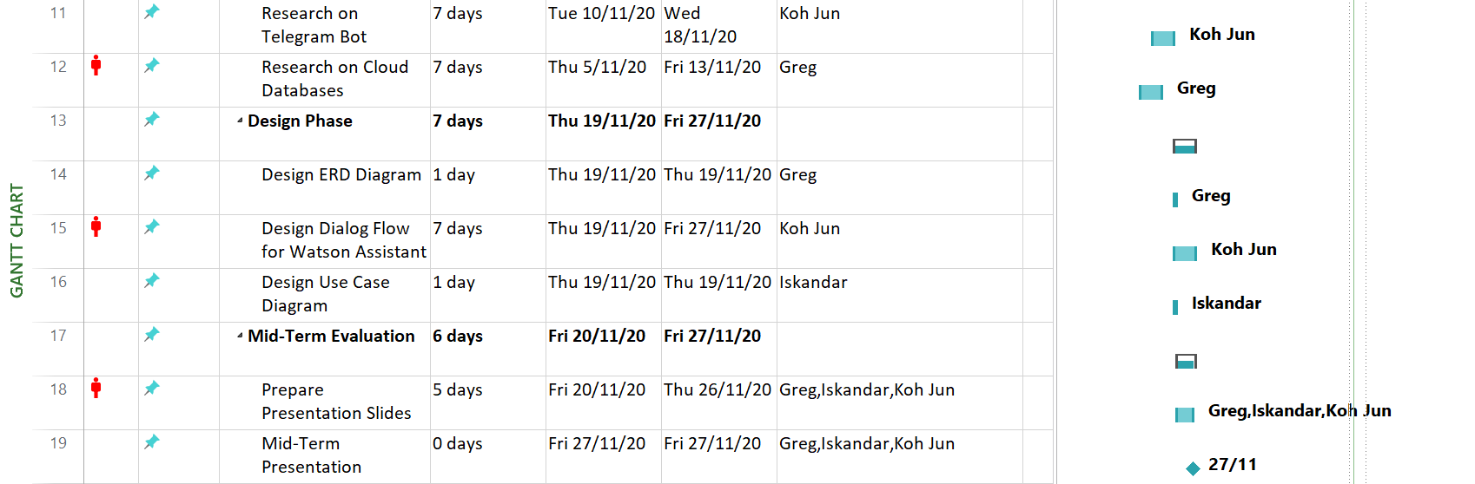
Gantt Chart

Slide 10
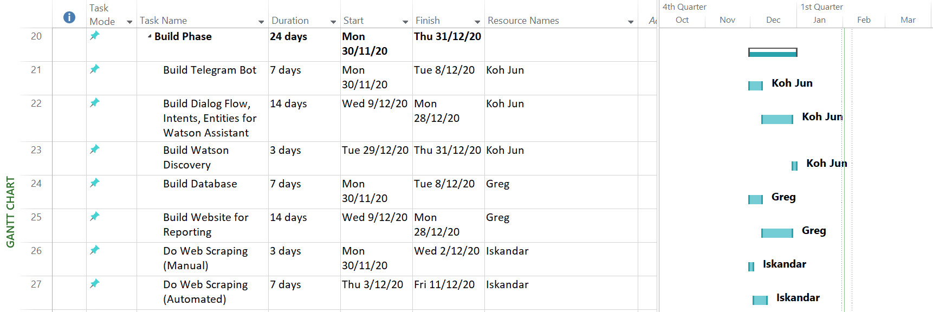
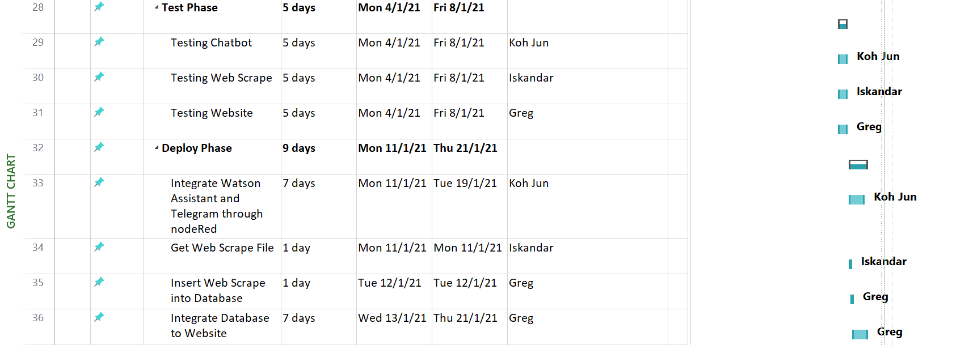
Gantt Chart (Cont.)

Slide 11
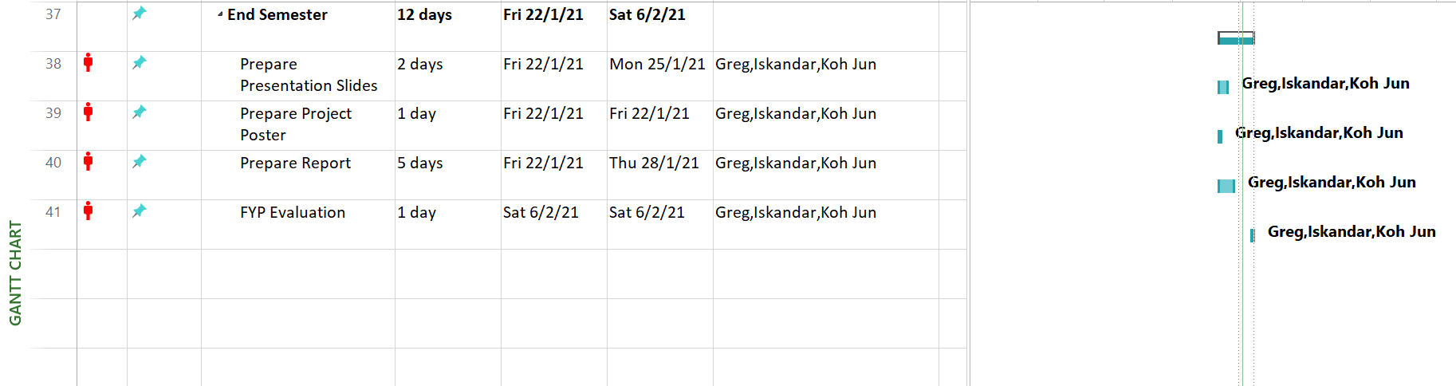
Gantt Chart (Cont. (2))

Slide 12
Task Allocation and Progress (Koh Jun)
Task | Progress | Remarks
Create Telegram Bot | 100%
Create Chat Engine | 100%
Integrating Telegram API | 100%
Improve bot architecture | 100%
Implement chat engine dialog flow | 100%
Web Scrape | 100%
Integrate with other channels | 20% | Unable to integrate Watson Assistant with Whatsapp and Facebook. Web integration works, but unable to produce scraped result.

Slide 13
Task Allocation and Progress (Isk)
Task | Progress | Remarks
Decide on fields/data to scrape | 100%
Web scrape job listings | 100%
Convert data to .csv file | 100%
Schedule Web Scraper to automatically scrape at 08:00 each day | 80%
Send email with .csv attached | 50% | unable to connect to IMTP server using gmail

Slide 14
Task Allocation and Progress (Greg)
Task | Progress | Remarks
Create Database | 80%
Find out required fields needed for database and reporting | 100%
Create HTML Page for Reports | 80%
Reports | 30%

Slide 15
Records of Team Meetings with Supervisor
Name | Date 1 | Date 2 | Date 3 | Date 4 | Date 5 | Date 6
Iskandar | Present | Present | Present | Present | Present | Present
Koh Jun | Present | Present | Present | Present | Present | Present
Greg | Present | Present | Present | Present | Present | Present
Name | Date 7 | Date 8 | Date 9 | Date 10 | Date 11 | Date 12 | Date 13
Iskandar | Present | Present | Present | Present | Present | Present | Present
Koh Jun | Present | Present | Present | Present | Present | Present | Present
Greg | Present | Present | Present | Present | Present | Present | Present

Slide 16
Project Walk Through / Demonstration

Slide 17
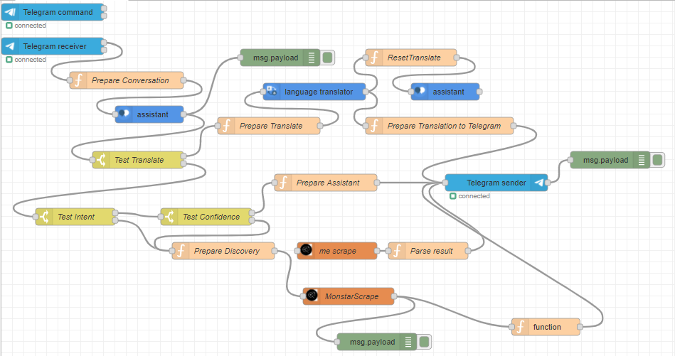
Node-red flow:

Slide 18
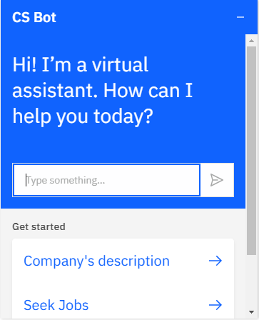
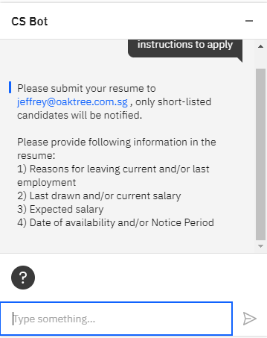
Web chat
Interface of Web chatbot:
Example of enquiring Web Chatbot:

Slide 19
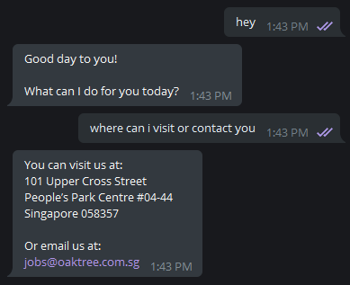
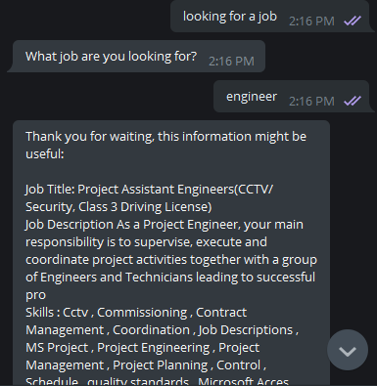
Telegram
Basic enquiry:
Enquiring on jobs:

Slide 20
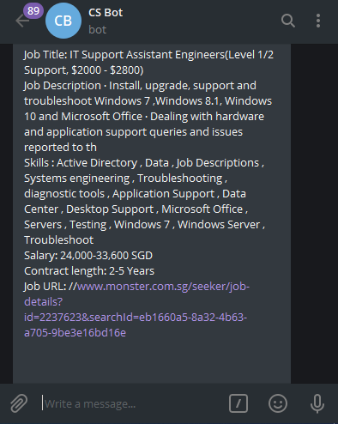
Telegram (Scraped results)
Job Title
Job description
Skill Sets needed for Job
Job Salary
Contract length for Job
Link to Job listings full description

Slide 21
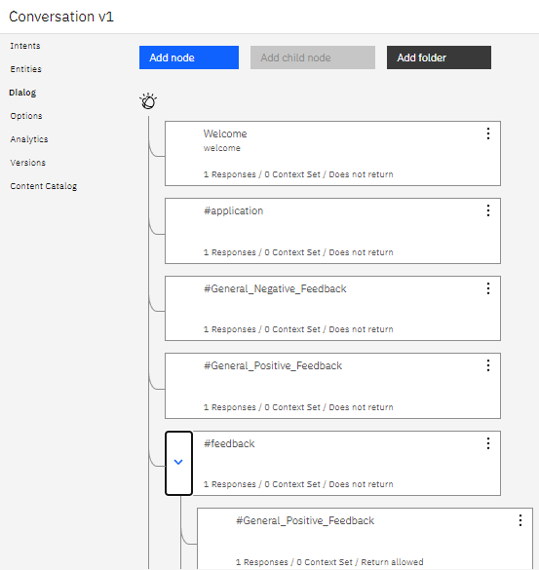
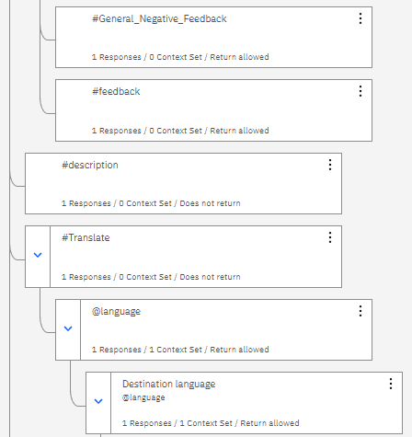
Watson Assistant flow 1

Slide 22
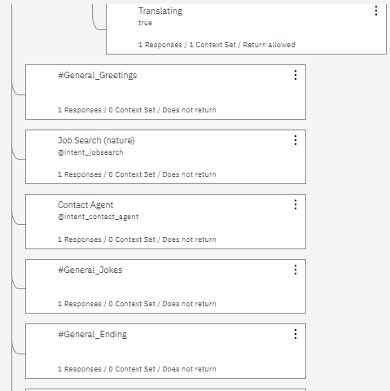
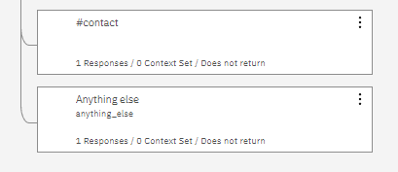
Watson Assistant flow 2

Slide 23
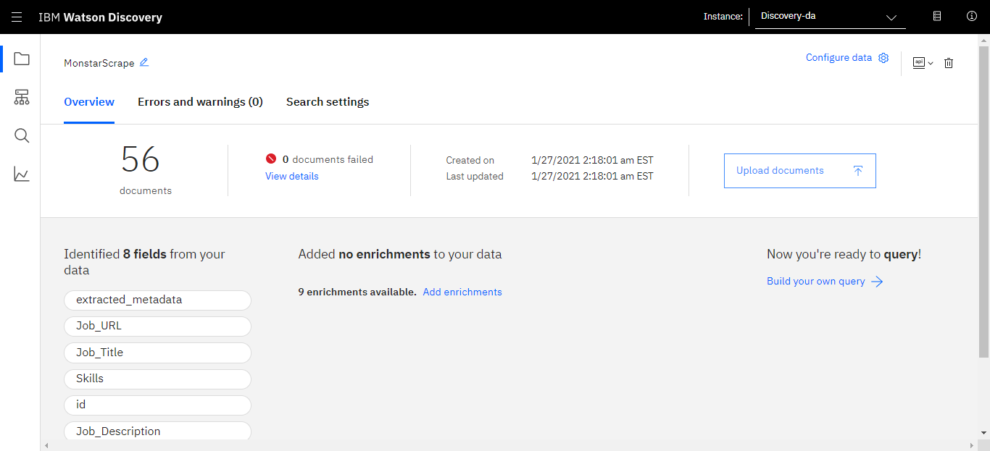
Update knowledge base
To update the knowledge base with fresh scraped data, user just have to upload it into the Watson Discovery workspace;
Since the fields and ground work is already set, nothing else needs to be done

Slide 24
Thank you

